Slide 1


Graphics API
HTML drawing
Notes:
© SUPINFO International University - http://www.supinfo.com
SUPINFO vous permet de partager ce document
Vous êtes libre de :
Partager — reproduire, distribuer et communiquer ce document Remixer — modifier ce document
A condition de respecter les règles suivantes :
Indication obligatoire de la paternité — Vous devez obligatoirement préciser l’origine « SUPINFO » du document au début de celui-ci de la même manière qu’indiqué par SUPINFO International University – Notamment en laissant obligatoirement la première et la dernière page du document, mais pas d'une manière qui suggérerait que SUPINFO International University vous soutiennent ou approuvent votre utilisation du document, surtout si vous le modifiez. Dans ce dernier cas, il vous faudra obligatoirement supprimer le texte « SUPINFO Official Document » en tête de page et préciser notamment la page indiquant votre identité et les modifications principales apportées.
En dehors de ces dispositions, aucune autre modification de la première et de la dernière page du document n’est autorisée.
NOTE IMPORTANTE : Ce document est mis à disposition selon le contrat CC-BY-NC-SA Creative Commons disponible en ligne http://creativecommons.org/licenses ou par courrier postal à Creative Commons, 171 Second Street, Suite 300, San Francisco, California 94105, USA modifié en ce sens que la première et la dernière page du document ne peuvent être supprimées en cas de reproduction, distribution, communication ou modification. Vous pouvez donc reproduire, remixer, arranger et adapter ce document à des fins non commerciales tant que vous respectez les règles de paternité et que les nouveaux documents sont protégés selon des termes identiques. Les autorisations au-delà du champ de cette licence peuvent être obtenues à support@supinfo.com.
© SUPINFO International University – EDUCINVEST - Rue Ducale, 29 - 1000 Brussels Belgium . www.supinfo.com

Slide 2

Course objectives
Graphics API
By completing this course you will be able to:
Understand graphics API concept
Draw shapes with SVG
Draw shapes with Canvas
Choose one or the other depending on what you need to do

Slide 3

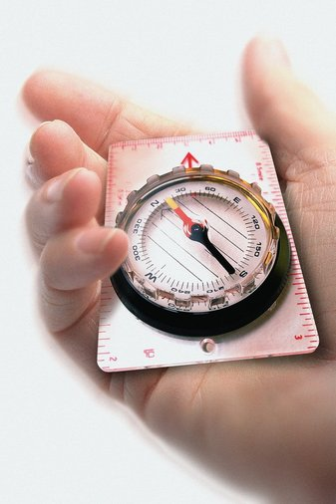
Course plan
Graphics API
SVG
Canvas
SVG or Canvas ?

Slide 4
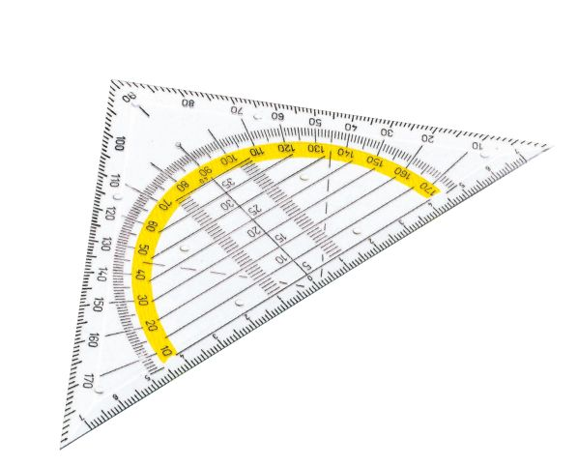
SVG
Graphics API

Slide 5

Presentation
SVG
Graphics in HTML5
Done by markups
Simple and quick rendering
Suitable for lightweight graphics
Preferred for static design
Already recommended by W3C

Slide 6
Syntax
SVG
Tag <svg>
Acts as a <div> element
Can contain several shapes
One tag by shape: <circle>, <line>, …
Enhanced by attributes
Specify origins, and dimensions

Slide 7
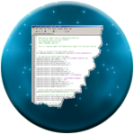
The SVG tag
SVG
The <svg> tag
Root element for your shapes defined inside
Their coordinates will be calculated from the SVG top left corner element
<svg xmlns="http://www.w3.org/2000/svg" version="1.1">
<!–- Your shapes here -->
</svg>

Slide 8
Line
SVG
Used to draw a line:
x1 and y1 for departure coordinates
x2 and y2 for arrival coordinates
<line x1="0" y1="0" x2="600" y2="600" fill="black" />

Slide 9

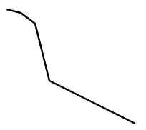
Polyline
SVG
Special line including many points:
Without fill attribute, just a multi-pointed line:
<polyline
points="0,10 20,10 30,20 50,0 70,20
90,0 110,20,120,10 150,10"
fill="red" stroke="black" stroke-width="3" />
<polyline points="20,20 40,25 60,40 80,
120 120,140 200,180"
style="fill:none;stroke:black;
stroke-width:3" />

Slide 10
Rect
SVG
Used to draw a rectangle:
x and y for coordinates
width and height for dimensions
<rect x="550" y="0" width="300" height="400" fill="black" />

Slide 11
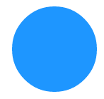
Circle
SVG
Used to draw a circle:
cx and cy for coordinates
r for radius
<circle cx="60" cy="60" r="30" fill="rgba(30, 150, 255, 1)" />

Slide 12

Ellipse
SVG
Almost same than circle:
cx and cy for coordinates
rx and ry for radius
<ellipse cx="60" cy="60" rx="30" ry="60" fill="blue" />

Slide 13
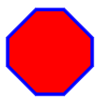
Polygon
SVG
Designs shapes with at least three points:
Unlike polyline, all the lines connect up (ex: the first and the end point is connected)
Same attributes than polyline
<polygon points="40,10 70,10 100,40 100,70
70,100, 40,100 10,70, 10,40"
style="fill: red; stroke: blue; stroke-width: 4;" />

Slide 14

Text
SVG
Outputs a simple text:
Mostly like a <span> element, but in SVG!
Can be reshaped thanks to the « transform » attribute
<text x="15" y="15" fill="brown"
transform="rotate(45)"
style="font-size: 24px;" >
Take me to the top!
</text>

Slide 15

Text
SVG
Outputs a simple text:
If you want to jump lines, enclose each line by the <tspan> tag and specify their coordinates!
x and y is related to the svg container’s coordinates
dx and dy is added to the previous element’s coordinates
<text y="15" fill="brown" transform="rotate(45)"
style="font-size: 24px;" >
<tspan x="75">SVG</tspan>
<tspan dy="20" x="75">is soooo</tspan>
<tspan dy="20" x="75">cool</tspan>
</text>

Slide 16
Filters
SVG
SVG also provides filters!
Simple tags to apply over SVG components
Change shapes, colors, opacity, …
Useful for animations and picture retouching!
Can be defined two ways:
By the « filter » CSS property
Directly in the shape tag (circle, rect, …)

Slide 17
Filters
SVG
Filters are encapsulated inside the <defs> tag
Containing all definitions for filters and gradients
Usage:
<svg xmlns=... >
<defs>
<!–- Filters and/or gradients -->
</defs>
<rect ... />
</svg>

Slide 18
Filters
SVG
In order to use your filters:
Define an id for each of them:
Link the filter to your shape thanks to the filter attribute:
<filter id="filter1" ... >
<!–- My filter –->
</filter>
<rect width="90" height="90" fill="yellow"
filter="url(#filter1)" />

Slide 19

Filter common attributes
SVG
Four optionnal attributes to remember:
You must specify their values in percentages
These attributes can truncate your SVG shape
Property | Default | Use
x | 0% | Moves the filter at right
y | 0% | Moves the filter at bottom
width | 100% | Specify the x-length of the filter
height | 100% | Specify the y-length of the filter
Notes:
Note : x and y don’t take fill-stroke attribute in consideration. Remove them if you planned to use this attribute, otherwise your border will be truncated.

Slide 20
Filter common attributes
SVG
Look at the following schema, and the example:
x
y
width
height
<filter id="filter1" x="20%" y="50%" width="70%" height="50%">
<!–- Some effects -->
</filter>

Slide 21

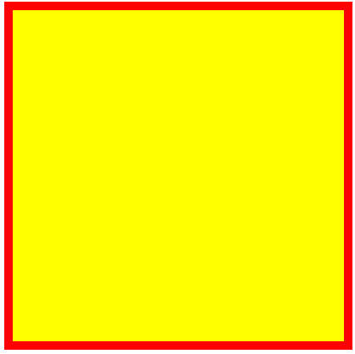
Filters
SVG
For the next examples, we’ll consider a single shape in our SVG element, described as follows:
<svg>
<defs>
<filter id="f1">
<!–- We’ll define our effects here -->
</filter>
</defs>
<rect width="400" height="400" x="10" y="10"
stroke-width="10" stroke="red"
fill="yellow" filter="url(#f1)" />
</svg>
Notes:
Some filters example here: http://www.html5rocks.com/en/tutorials/filters/understanding-css/

Slide 22
Effects
SVG
Many effects are available in SVG:
Flood
GaussianBlur
ColorMatrix
…
We’ll concentrate on these three!
Here is the complete list:
http://www.w3.org/TR/SVG/filters.html

Slide 23
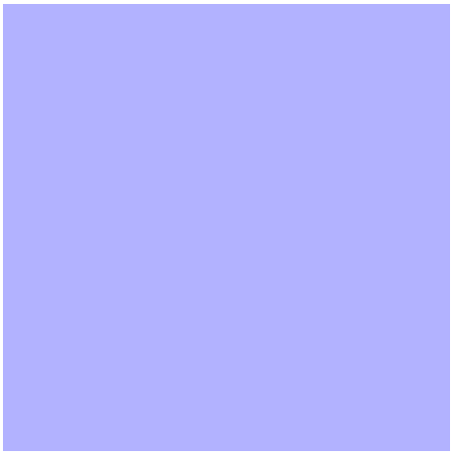
FeFlood
SVG
Covers the shape with the specified color:
Be careful: this will override fill and fill-stroke property
<feFlood flood-color="blue" flood-opacity=".3" />

Slide 24
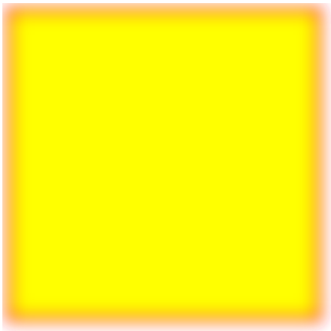
FeGaussianBlur
SVG
Performs on a gaussian blur:
Depending on the stdDevitation attribute
<feGaussianBlur stdDeviation="10" />

Slide 25
FeColorMatrix
SVG
Change your colors by:
HUE
Saturation
Luminance
A complete matrix
Here is a tool for better understanding:
http://www.colorsontheweb.com/colorwizard.asp

Slide 26
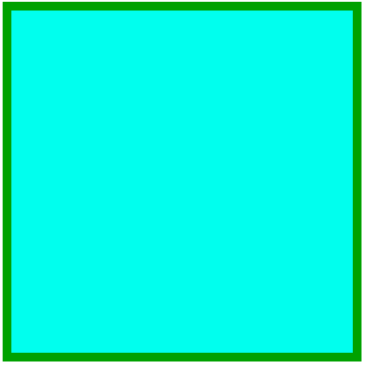
FeColorMatrix
SVG
HUE:
Takes one int argument as values
« Rotate » the base color
<feColorMatrix type="hueRotate" values="90" />

Slide 27

FeColorMatrix
SVG
Saturation:
Takes one real argument as values (from 0 to 1)
Saturates the base color
<feColorMatrix type="saturate" values="0.1" />

Slide 28

FeColorMatrix
SVG
Luminance:
Invert colors and associates them to a grey tone, depending on their luminance
<feColorMatrix type="luminanceToAlpha" />

Slide 29
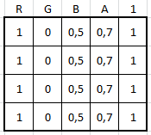
FeColorMatrix
SVG
Matrix:
Takes a complete 5 x 4 matrix:
Transforms base color by matrix multiplication
Example with a random base color: rgba(255, 0, 127, 0.7)
Transformed into matrix:
Notes:
More informations on matrix and svg look at these links:
http://www.svgbasics.com/filters4.html
https://dvcs.w3.org/hg/FXTF/raw-file/tip/filters/index.html#feColorMatrix

Slide 30
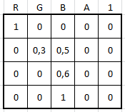
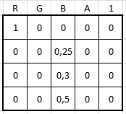
FeColorMatrix
SVG
Matrix reminders:
Let’s specify this random matrix:
Multiplication result:
Notes:
More informations on matrix and svg look at these links:
http://www.svgbasics.com/filters4.html
https://dvcs.w3.org/hg/FXTF/raw-file/tip/filters/index.html#feColorMatrix

Slide 31
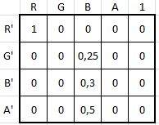
FeColorMatrix
SVG
Matrix reminders:
Now that we have the following result:
The resulting color will be:
Red = 255 x (1 + 0 + 0 + 0 + 0) = 255
Blue = 255 x (0 + 0 + 0.25 + 0 + 0) = 63
Green = 255 x (0 + 0 + 0.3 + 0 + 0) = 76
Alpha = 1 x (0 + 0 + 0.5 + 0 + 0) = 0.5
rgba(255,63,76,0.5)
Notes:
More informations on matrix and svg look at these links:
http://www.svgbasics.com/filters4.html
https://dvcs.w3.org/hg/FXTF/raw-file/tip/filters/index.html#feColorMatrix

Slide 32
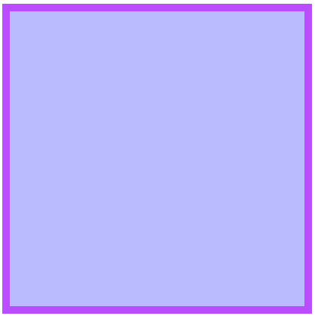
FeColorMatrix
SVG
Matrix:
SVG example:
<feColorMatrix type="matrix"
values="0 0 0 .33 0
0 .33 0 0 0
1 0 0 0 0
0 0 0 .7 0" />
Notes:
More informations on matrix and svg look at these links:
http://www.svgbasics.com/filters4.html
https://dvcs.w3.org/hg/FXTF/raw-file/tip/filters/index.html#feColorMatrix

Slide 33
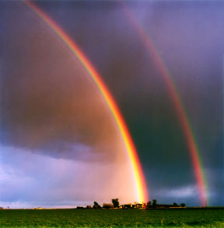
Gradients
SVG
As CSS3 gradient property:
Radial
Linear
Also defined in <defs> tag
Used with fill attribute

Slide 34
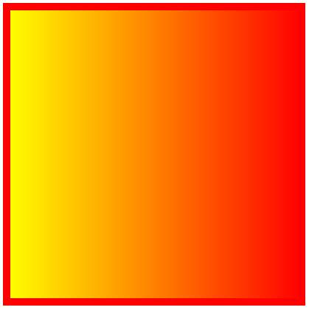
Linear Gradient
SVG
LinearGradient:
Don’t forget to change fill attribute on shape:
fill="url(#grad1)"
<linearGradient id="grad1">
<stop offset="0%" style="stop-color:rgb(255,255,0);
stop-opacity:1" />
<stop offset="100%" style="stop-opacity:1;
stop-color:rgb(255,0,0);" />
</linearGradient>
Notes:
More informations on matrix and svg look at these links:
http://www.svgbasics.com/filters4.html
https://dvcs.w3.org/hg/FXTF/raw-file/tip/filters/index.html#feColorMatrix

Slide 35
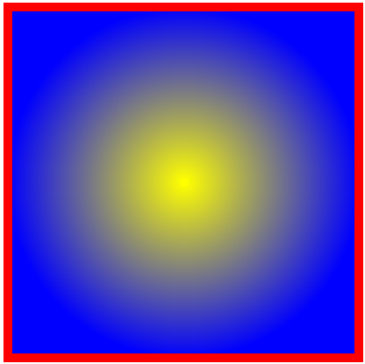
Radial Gradient
SVG
RadialGradient:
Don’t forget to change fill attribute on shape:
fill="url(#grad1)"
<radialGradient id="grad1">
<stop offset="0%" style="stop-color:rgb(255,255,0);
stop-opacity:1" />
<stop offset="100%" style="stop-opacity:1;
stop-color:rgb(0,0,255);" />
</radialGradient>
Notes:
More informations on matrix and svg look at these links:
http://www.svgbasics.com/filters4.html
https://dvcs.w3.org/hg/FXTF/raw-file/tip/filters/index.html#feColorMatrix

Slide 36
CSS with SVG
SVG
Of course you can take advantage of CSS with SVG
Even use CSS3 namespaces!
Like all other tags, SVG is part of the DOM
Easily accessible with CSS…
…and JavaScript!

Slide 37
<html>
<head>
<title>SVG example</title>
<style>
/* Define namespaces before anything else */
@namespace "http://www.w3.org/1999/xhtml";
@namespace s "http://www.w3.org/2000/svg";
figure { width: 180px; text-align: center; }
s|svg { margin: 10px 30px; height: 120px; }
s|svg polygon { opacity: .5; }
</style>
</head>
<body>
<h1>Look at my SVG!</h1>
<!-- ... -->
CSS3 namespaces and SVG

Slide 38
<!-- ... -->
<figure>
<svg>
<defs>
<filter id="f1">
<feColorMatrix type="hueRotate"
values="90"/>
<feGaussianBlur stdDeviation="5" />
</filter>
</defs>
<polygon … filter="url(#f1)" />
</svg>
<figcaption>SVG rocks</figcaption>
</figure>
</body>
</html>
CSS3 namespaces and SVG

Slide 39


Questions?

Slide 40
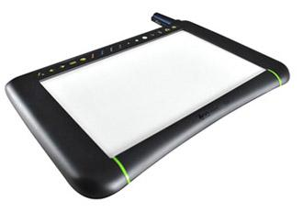
Canvas API
Graphics API

Slide 41
Presentation
Canvas API
JavaScript API
Only one DOM node: <canvas>
All your shapes are created programmatically
Bitmap rendering
Can draw in two and in three dimensions
Called respectively 2D and WebGL

Slide 42
Canvas context
Canvas API
The canvas tag:
Defines a drawable area
Has two contexts (one for 2D, the other for 3D)
Mandatory to create shapes
<canvas id="canvas1"></canvas>
<script type="text/javascript">
var context =
document.getElementById("canvas1").getContext("2d");
</script>
Notes:
You can also define the same canvas in JavaScript, as follows:
var canvas = document.createElement('canvas');
canvas.id = "canvas1";
var context = canvas.getContext("2d");
document.body.appendChild(canvas);

Slide 43
Canvas basics
Canvas API
Shapes’ origin are usually defined by a kind of cursor
You can move this cursor!
Just like hovering your pencil over your sheet
Call « stroke() » at the end of your drawing:
var context =
document.getElementById("canvas1").getContext("2d");
context.moveTo(100, 50); // 100px from left, 50px from top
context.stroke(); // Outputs the shape

Slide 44
Line
Canvas API
Used to draw a line:
Departure coordinates are defined by your cursor
context.lineTo(x, y);
context.moveTo(0, 0); // Move cursor at top left corner
context.lineTo(50, 50); // From 0,0 to 50,50

Slide 45
Rect
Canvas API
Used to draw a rectangle:
context.rect(x, y, width, height);
context.rect(550, 0, 300, 400);

Slide 46
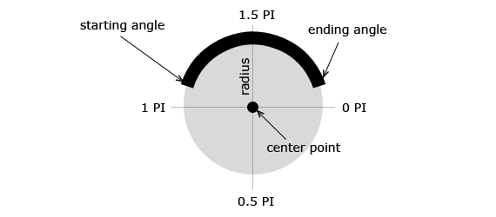
Arc
Canvas API
Used to draw an arc:
Before viewing the syntax, take a look at the following schema:
Source: http://www.html5canvastutorials.com

Slide 47

Arc
Canvas API
Used to draw an arc:
context.arc(x, y, radius, start, end, counterClockWise);
context.arc(250, 200, 75, Math.PI, 0, true);

Slide 48
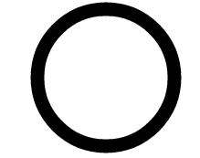
Arc
Canvas API
Also possible to draw circles:
context.arc(x, y, radius, start, end, counterClockWise);
context.arc(250, 200, 75, 2 * Math.PI, 0, true);

Slide 49
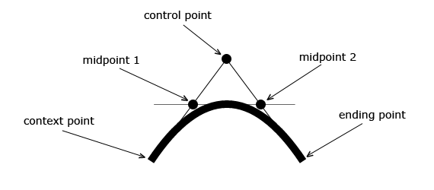
Curves
Canvas API
Two types of curves: quadratic and Bezier
Before viewing the syntax, take a look at the following quadratic curve schema:
Source: http://www.html5canvastutorials.com

Slide 50
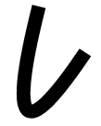
Quadratic Curve
Canvas API
Curve with one control point
Origin defined by your current cursor position
context.quadraticCurveTo(cX, cY, endX, endY);
context.moveTo(200, 0);
context.quadraticCurveTo(50, 300, 150, 150);

Slide 51
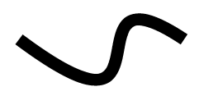
Bezier Curve
Canvas API
Curve with two control points
Origin defined by your current cursor position
context.bezierCurveTo(cX1, cY1, cX2, cY2, endX, endY);
context.moveTo(200, 0);
context.bezierCurveTo(300, 250, 150, 0, 300, 100);

Slide 52
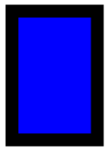
Context attributes
Canvas API
Change drawing style:
Be sure to set it up before « fill() » and/or « stroke() »!
context.rect(100, 150, 100, 150); // Draw a rectangle
context.lineWidth = 15; // Width in pixels
context.strokeStyle = "rgba(0, 0, 0, 1)"; // Black
context.fillStyle = "blue"; // Change inner color
context.fill(); // Fill rectangle
Context.stroke(); // Draw borders

Slide 53
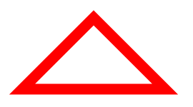
Canvas basics
Canvas API
Canvas allows to « auto-close » your shapes
Last point will be linked to first one by a straight line
context.beginPath(); // Start drawing the shape
context.moveTo(100, 300);
context.lineTo(200, 200);
context.lineTo(300, 300);
context.strokeStyle = "red";
context.lineWidth = 15;
context.closePath(); // End drawing the shape
context.stroke();

Slide 54

Text
Canvas API
Outputs a simple text
No need to use « stroke() » function
context.fillText(text, x, y);
context.fillText("Canvas rocks!", 100, 100);

Slide 55
Text
Canvas API
Change font defaults:
context.font = attributes;
context.font = "italic 40px Calibri";

Slide 56

Image
Canvas API
Drawing an image:
var oImage = new Image();
oImage.onload = function() {
context.drawImage(oImage, 700, 50);
};
oImage.src = "/img/success.png";

Slide 57
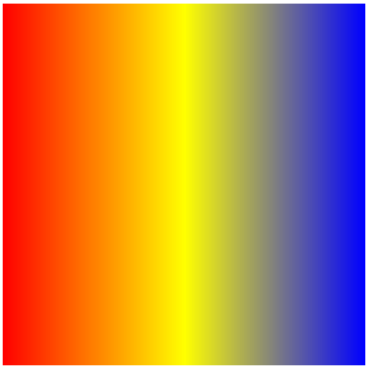
LinearGradient
Canvas API
Create gradient by relying on an imaginary line:
context.createLinearGradient(x1, y1, x2, y2);
var grd = context.createLinearGradient(100, 100, 500, 100);
grd.addColorStop(0,"red");
grd.addColorStop(.5, "yellow");
grd.addColorStop(1, "blue");
context.rect(100, 100, 500, 500);
context.fillStyle = grd;
context.fill();

Slide 58
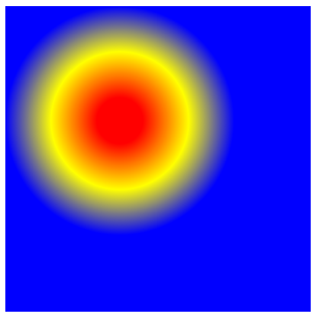
RadialGradient
Canvas API
Create gradient by relying on two imaginary circles:
context.createRadialGradient(x1, y1, r1, x2, y2, r2);
var grd = context.createRadialGradient(250, 250, 30, 250,
250, 150);
grd.addColorStop(0,"red");
grd.addColorStop(.5, "yellow");
grd.addColorStop(1, "blue");
context.rect(100, 100, 500, 500);
context.fillStyle = grd;
context.fill();

Slide 59
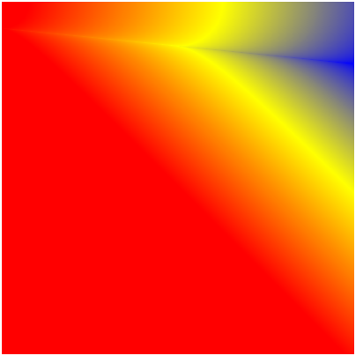
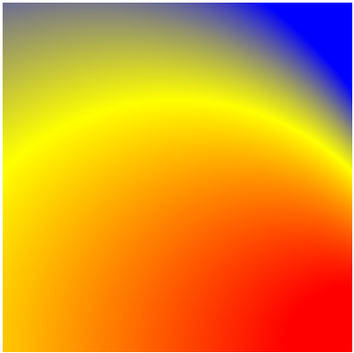
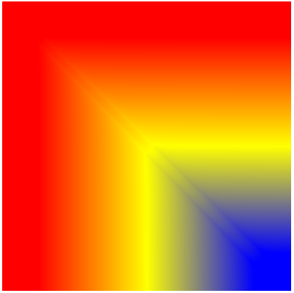
RadialGradient
Canvas API
With radial gradients, you can put the two circles where you want
Allows all gradient types you need
(100, 100, 30, 500, 100, 70)
(500, 500, 75, 100, 500, 500)
(150, 150, 5, 450, 450, 10)

Slide 60

WebGL (Canvas 3D)
Canvas API
Canvas 3D API (WebGL):
Based on OpenGL
Built in modern browsers without any plug-ins use
Use graphic processing unit (GPU) through GLSL language

Slide 61
WebGL (Canvas 3D)
Canvas API
Canvas 3D API (WebGL):
Some examples:
http://mrdoob.com/
http://learningwebgl.com/blog/?page_id=1217
http://triggerrally.com/

Slide 62
Questions?

Slide 63

SVG or Canvas ?
Graphics API
Both can draw, so which one to use?

Slide 64

Advantages
SVG or Canvas ?
SVG is great because:
Simple syntax
DOM elements allowing to use CSS and JS
Canvas is great because:
It’s all dynamic
Everything is a pixel

Slide 65
Disadvantages
SVG or Canvas ?
But SVG is:
Slow when DOM complexity increases
Only bi-dimensional
But SVG has:
No animation API
Poor text rendering capabilities

Slide 66
Conclusion
SVG or Canvas ?
SVG is designed for:
Cross-platform rendering
Data charts, interactive UI, …
Canvas is designed for:
High speed rendering (for example games)
Image editing, color picker, …

Slide 67
Questions?

Slide 68

The end
Graphics API
Thanks for your attention

